Slide 1
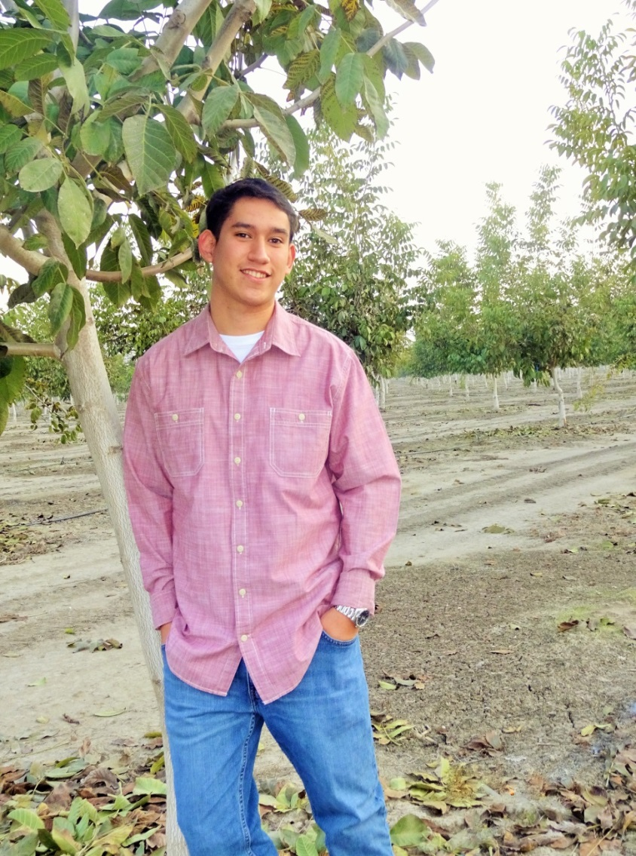
My Senior Exit Interview
By: Carlos Servin

Slide 2
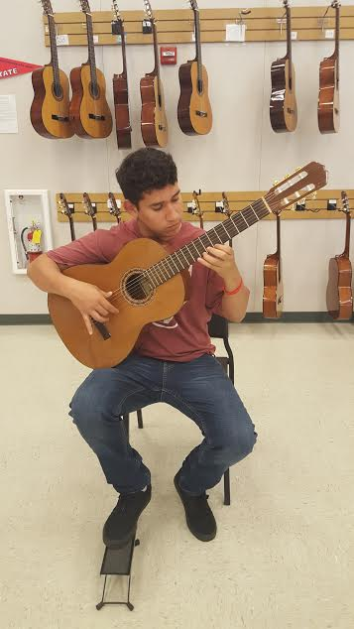
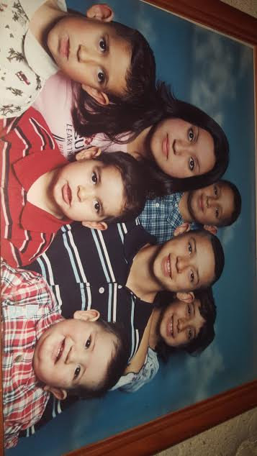
About Me
I’m a senior at Lindsay High
I enjoy being outdoors
Family of nine
I love playing guitar
I’m always willing to try new things

Slide 3
Challenges
Tend to procrastinate
Turned in my work last minute
I would study the night before an exam
Overcoming this problem
Set reminders
Sticky notes on my binder

Slide 4
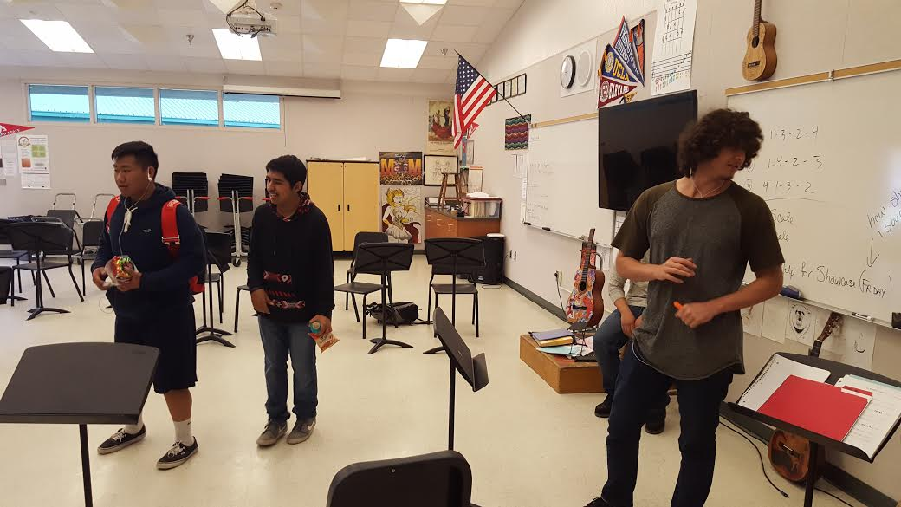
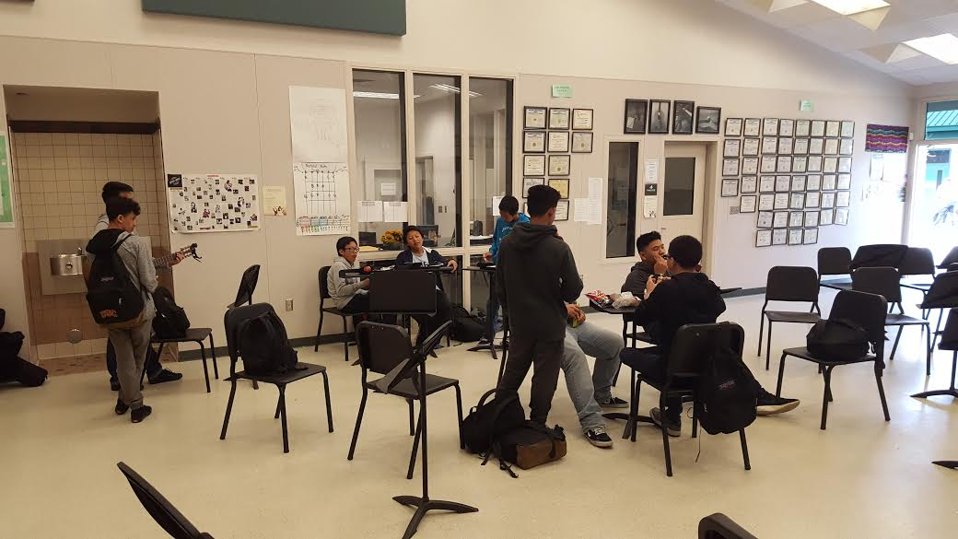
Experiences
I played basketball freshman year
I joined the guitar club

Slide 5
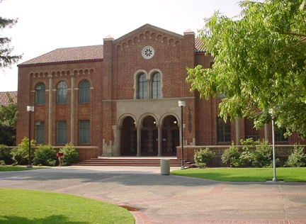
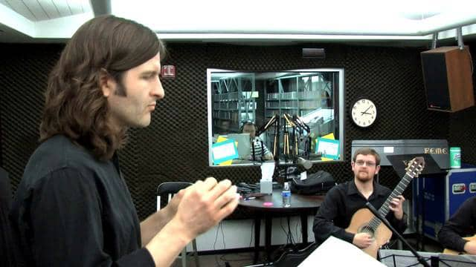
Job Shadow
Fresno City Community College with professor Cooper
Learned a lot
My observation
He is teaches at a slow pace
Good for slow learners
He notices when a student is struggling and requires assistance

Slide 6
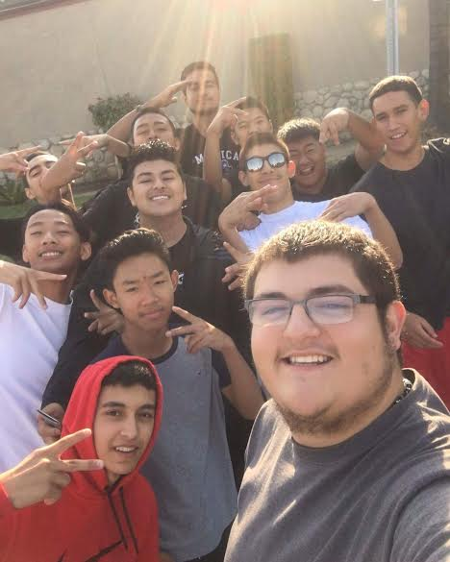
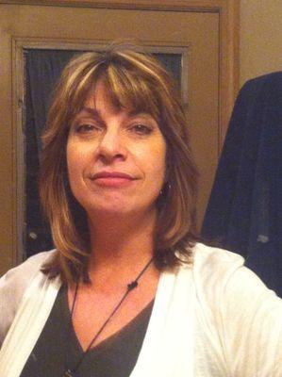
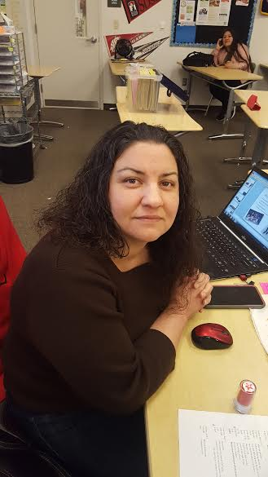
Leaving High-School
Excited
Nervous
Bummed
Great memories
Met amazing teachers

Slide 7
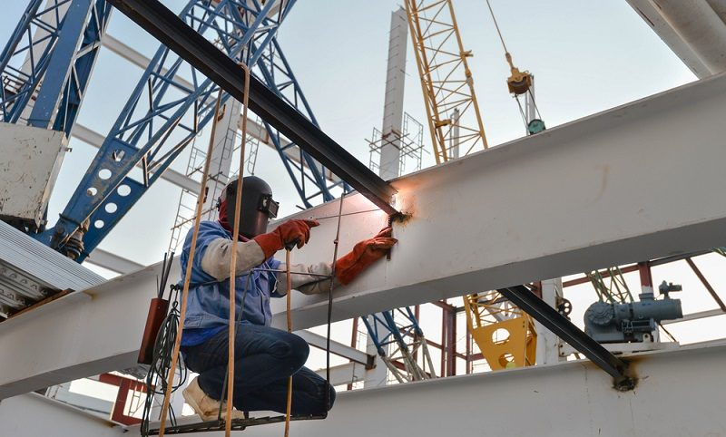
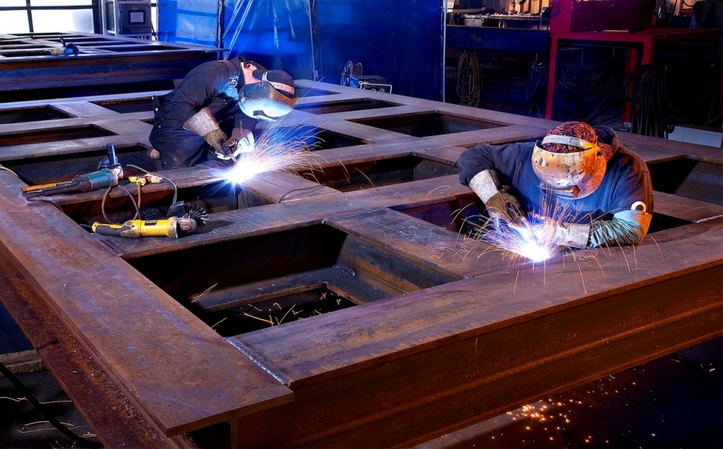
My Plans
Planning on going to College of the Sequoias
Finish my general education then transfer to Fresno State
There I’m planning on studying structural steel fabrication

Slide 8
Thank You for Your Time
Any questions?

